Slide 1
Lesson 20
Introduction to MySQL & Relational Databases (Part-2)
Python Hybrid - Autumn 2024

Slide 2
Overview
Review of Part 1 concepts.
Advanced SQL Queries and Python Integration.
Working with Joins and Aggregate Functions.

Slide 3
Quick Recap of Part 1

Slide 4
Recap
Topics Covered:
Basics of MySQL and Python integration.
Database and table creation.
CRUD operations.

Slide 5
Installing MySQL
Windows
Download MySQL Installer.
Follow GUI steps to install.
Install and open MySQL Workbench or use the command line.
Linux Installation
sudo apt update
sudo apt install mysql-server
sudo mysql_secure_installation
MacOS
brew install mysql
brew services start mysql

Slide 6
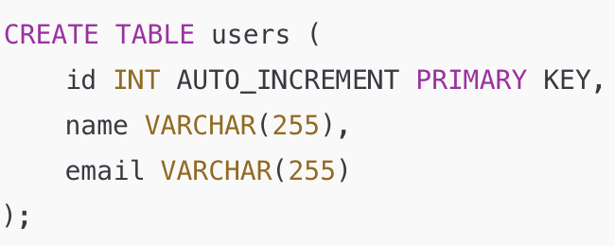
Basic SQL Commands
SHOW DATABASES: List all databases.
CREATE DATABASE: Create a new database.
CREATE TABLE: Define tables for structured data.
INSERT INTO: Add rows to tables.
SELECT: Retrieve data from tables.
UPDATE: Modify existing data.
DELETE: Remove data.

Slide 7
Hands-On Exercise
Create a database called as “online_movie_rating”

Slide 8
Hands-On Exercise
Create table
movies contains general information about movies and has the following attributes:
id
title
release_year
genre
collection_in_mil

Slide 9
Hands-On Exercise
Create table
reviewers contains details about reviewers:
id
first_name
last_name

Slide 10
Hands-On Exercise
Download file movies.json from google classroom and read it and insert all the data into movies table.
Download file reviewers.json from google classroom, read it and inserts all the data into reviewers table

Slide 11
Hands-On Exercise
Query all the movies from the movie table for and print name and release year of the movies

Slide 12
Tables with Relationships
What is a Foreign Key?
A foreign key links a column in one table to the primary key in another table.
Enforces referential integrity by ensuring valid relationships between tables.
Types of relationships
One-to-One: Ideal for splitting data into related entities to reduce redundancy.
One-to-Many: Most commonly used in relational databases.
Many-to-Many: Requires a junction table to manage relationships.

Slide 13
One-to-One Relationship
Each row in Table A is linked to one and only one row in Table B.
Example: A user table and a profile table, where each user has exactly one profile.
CREATE TABLE users (
user_id INT AUTO_INCREMENT PRIMARY KEY,
user_name VARCHAR(255)
);
CREATE TABLE profiles (
profile_id INT AUTO_INCREMENT PRIMARY KEY,
user_id INT UNIQUE,
bio TEXT,
FOREIGN KEY (user_id) REFERENCES users(user_id)
);

Slide 14
One-to-Many Relationship
Each row in Table A is linked to many rows in Table B.
Example: A class table and a students table, where each class has many students.
CREATE TABLE classes (
class_id INT AUTO_INCREMENT PRIMARY KEY,
class_name VARCHAR(255)
);
CREATE TABLE students (
student_id INT AUTO_INCREMENT PRIMARY KEY,
student_name VARCHAR(255),
class_id INT,
FOREIGN KEY (class_id) REFERENCES classes(class_id)
);

Slide 15
Many-to-Many Relationship
Rows in Table A can be linked to multiple rows in Table B and vice versa.
Example: A students table and a courses table, where a student can enroll in multiple courses, and a course can have multiple students
CREATE TABLE students (
student_id INT AUTO_INCREMENT PRIMARY KEY,
student_name VARCHAR(255)
);
CREATE TABLE courses (
course_id INT AUTO_INCREMENT PRIMARY KEY,
course_name VARCHAR(255)
);
CREATE TABLE student_courses (
student_id INT,
course_id INT,
FOREIGN KEY (student_id) REFERENCES students(student_id),
FOREIGN KEY (course_id) REFERENCES courses(course_id)
);

Slide 16
Hands-On Exercise
Create table
ratings contains actual information about rating along with movie and reviewer ids.:
rating
movie_id (ForeignKey Movies Table)
reviewer_id (ForeignKey reviewers Table)

Slide 17
Why Do we need Database?

Slide 18
Challenges of Using Files for Data Storage
Data Integrity Issues:
No built-in mechanisms to ensure data consistency.
High risk of overwriting or corrupting data.
Limited Query Capabilities:
Searching and filtering data in files can be slow and inefficient.
Requires custom code for complex queries.
Scalability Concerns:
Difficult to manage large volumes of data in flat files.
Performance decreases as file size grows.
Data Redundancy and Duplication:
Files lack built-in mechanisms to eliminate redundant data.

Slide 19
Pros for using Database
Structured Data Management:
Stores data in tables with relationships.
Enforces rules like primary keys and foreign keys to maintain integrity.
Efficient Data Retrieval:
SQL provides powerful query capabilities for filtering, sorting, and aggregating data.
Concurrency Control:
Allows multiple users to access and modify data simultaneously without conflicts.
Scalability:
Databases are designed to handle large datasets and high-volume operations efficiently.
Data Security:
Supports authentication, encryption, and user-level permissions.

Slide 20
When do we use Database
Use Files When:
Data is simple, small-scale, and static (e.g., configuration files, logs).
Low frequency of read/write operations is acceptable.
Use a Database When:
Data is relational and requires structure (e.g., tables with relationships).
Large datasets need to be stored, queried, and updated frequently.
High performance and reliability are critical for the application.
Data needs to be accessed by multiple users or systems concurrently.

Slide 21
Advanced Select Query

Slide 22
Filtering
Filtering data with WHERE clause
Different comparators like =,>,<, etc can be used to filter the data in tables
cursor.execute("SELECT * FROM movies WHERE release_year > 2010")
for row in cursor.fetchall():
print(row)

Slide 23
Sorting
Sorting data with ORDER BY
DESC for descending order
ASC for ascending order (Default)
cursor.execute("SELECT * FROM movies ORDER BY release_year DESC")

Slide 24
Limiting
Limiting results with LIMIT
cursor.execute("SELECT * FROM movies LIMIT 10")
cursor.execute("SELECT * FROM movies ORDER BY release_year DESC LIMIT 10")

Slide 25
Aggregation

Slide 26
What is Aggregation?
Aggregation involves summarizing data to provide meaningful insights.
COUNT(): Counts the number of rows.
SUM(): Adds up values.
AVG(): Calculates the average value.
MAX(): Finds the maximum value.
MIN(): Finds the minimum value.

Slide 27
Aggregation in SQL
SELECT COUNT(*) AS total_movies FROM movies;
SELECT AVG(rating) AS avg_rating FROM ratings;
SELECT MAX(rating) AS highest_rating FROM ratings;

Slide 28
JOINS

Slide 29
Understanding Joins in SQL
What is a Join?
A join combines data from two or more tables based on a related column.
It allows you to retrieve meaningful information by connecting tables.

Slide 30
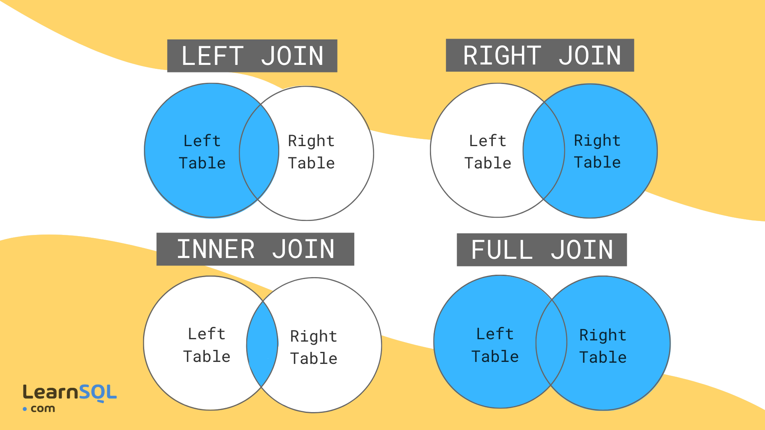
Type of Joins

Slide 31
Type of Joins
INNER JOIN: Retrieves rows that have matching values in both tables.
LEFT JOIN: Retrieves all rows from the left table, and matching rows from the right table. If no match, shows NULL.
RIGHT JOIN: Opposite of LEFT JOIN. Retrieves all rows from the right table, and matching rows from the left table.
FULL OUTER JOIN: Retrieves all rows from both tables, with NULL for non-matching rows (not always supported).

Slide 32

Exercises

Slide 33
Complete the following exercises
In ‘online_movie_rating’ database
Find all movies which were released after 2020
Find all movies which were
Get list of top 5 rated movies

Slide 34

Before you go…
Please take 2 minutes to give us feedback on today’s lesson.
This feedback is anonymous and only seen by the DCP team!
Scan the QR code or go to: https://redischool.typeform.com/lessonfeedback

Slide 35
Thank you for your attention!
See you next class!

